Slide 1
Measuring Data Similarity and Dissimilarity
Data Mining: Concepts and Techniques

Slide 2
Similarity and Dissimilarity
Similarity
  Numerical measure of how alike two data objects are
  Value is higher when objects are more alike- similar
  Often falls in the range [0,1]
Dissimilarity (e.g., distance)
  Numerical measure of how different two data objects are
  Lower when objects are more alike
  Minimum dissimilarity is often 0
  Upper limit varies
Proximity refers to a similarity or dissimilarity

Slide 3


Data Matrix and Dissimilarity Matrix
Data matrix
  n data points with p dimensions
  Two modes
Dissimilarity matrix
  n data points, but registers only the distance
  A triangular matrix
  Single mode
data matrix is often called a two-mode matrix.
The dissimilarity matrix contains one kind of entity (dissimilarities) and so is called a one-mode matrix.

Slide 4
How is dissimilarity computed between objects described by nominal attributes?
When objects are described by nominal attributes (i.e., categorical variables with no inherent order — like color, gender, or city),
we cannot compute dissimilarity using numerical distance (like Euclidean).
Instead, we use a simple matching approach.

Slide 5

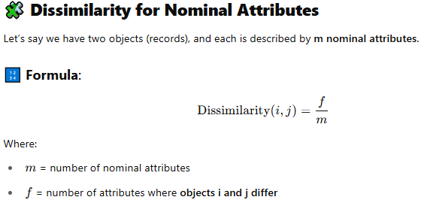
How is dissimilarity computed between objects described by nominal attributes?

Slide 6
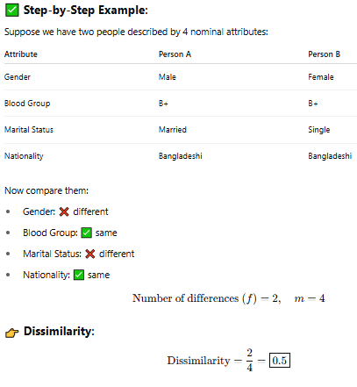
How is dissimilarity computed between objects described by nominal attributes?

Slide 7
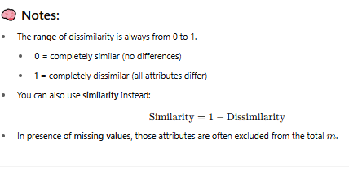
How is dissimilarity computed between objects described by nominal attributes?

Slide 8
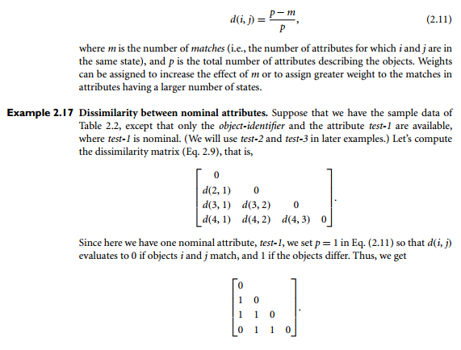
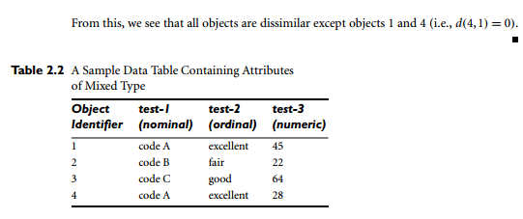
How is dissimilarity computed between objects described by nominal attributes?

Slide 9
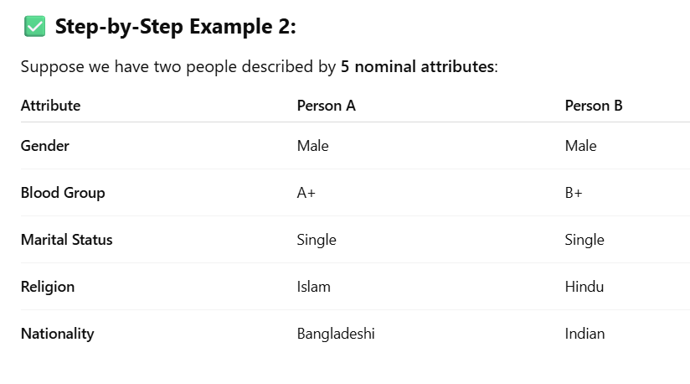
Another example computing dissimilarity between two people based on nominal attributes

Slide 10
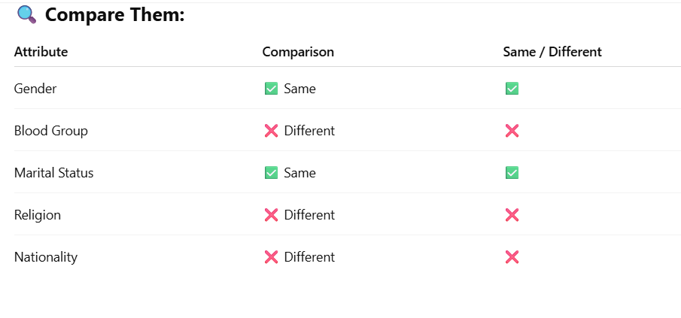
Another example computing dissimilarity between two people based on nominal attributes

Slide 11
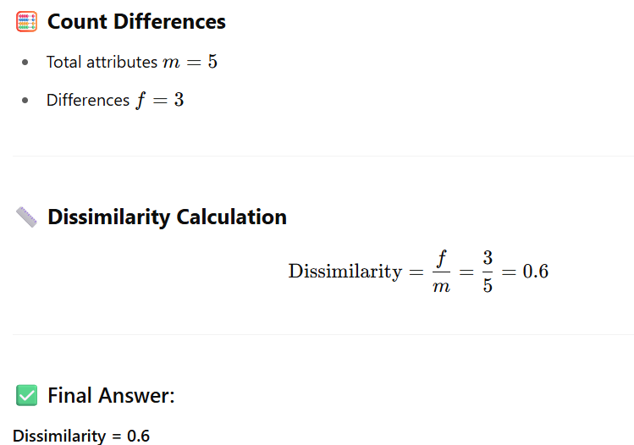
Another example computing dissimilarity between two people based on nominal attributes

Slide 12
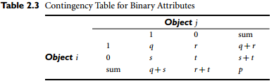
“how can we compute the dissimilarity between two binary attributes?”
One approach involves computing a dissimilarity matrix from the given binary data.
If all binary attributes are thought of as having the same weight, we have the 2X2 contingency table of Table 2.3, where
  q is the number of attributes that equal 1 for both objects i and j ,
  r is the number of attributes that equal 1 for object i but equal 0 for object j ,
  s is the number of attributes that equal 0 for object i but equal 1 for object j , and
  t is the number of attributes that equal 0 for both objects i and j .
  The total number of attributes is p, where p = q + r + s +t .

Slide 13

“how can we compute the dissimilarity between two binary attributes?”
Recall that for symmetric binary attributes, each state is equally valuable.
Dissimilarity that is based on symmetric binary attributes is called symmetric binary dissimilarity.
If objects i and j are described by symmetric binary attributes, then the dissimilarity between i and j is

Slide 14

“how can we compute the dissimilarity between two binary attributes?”
For asymmetric binary attributes, the two states are not equally important, such as the positive (1) and negative (0) outcomes of a disease test.
Given two asymmetric binary attributes, the agreement of two 1s (a positive match) is then considered more significant than that of two 0s (a negative match).
Therefore, such binary attributes are often considered “monary” (having one state).
The dissimilarity based on these attributes is called asymmetric binary dissimilarity, where the number of negative matches, t , is considered unimportant and is thus ignored in the following computation:

Slide 15
“how can we compute the dissimilarity between two binary attributes?”
Complementarily, we can measure the difference between two binary attributes based on the notion of similarity instead of dissimilarity.
For example, the asymmetric binary similarity between the objects i and j can be computed as
The coefficient sim(i, j ) is called the Jaccard coefficient and is popularly referenced in the literature.

Slide 16
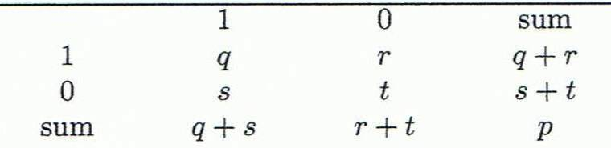
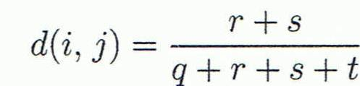
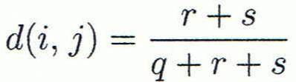

Proximity Measure for Binary Attributes
Object j
A contingency table for binary data
Distance measure for symmetric binary variables:
Distance measure for asymmetric binary variables:
Jaccard coefficient (similarity measure for asymmetric binary variables):
Object i

Slide 17


Dissimilarity between Binary Variables
Example
  Gender is a symmetric attribute
  The remaining attributes are asymmetric binary
  Let the values Y and P be 1, and the value N be 0
  These measurements suggest that Jim and Mary are unlikely to have a similar disease because they have the highest dissimilarity value among the three pairs. Of the three patients, Jack and Mary are the most likely to have a similar disease

Slide 18
Simple Example: Job Candidate Technical Skills
A tech company is evaluating three job candidates—Anik, Riya, and Sakib—based on their skill sets.
Candidate | City | Python | SQL | React | Machine Learning
Anik | Dhaka | Y | Y | Y | N
Riya | Dhaka | Y | Y | N | N
Sakib | Chittagong | N | N | N | Y

Slide 19
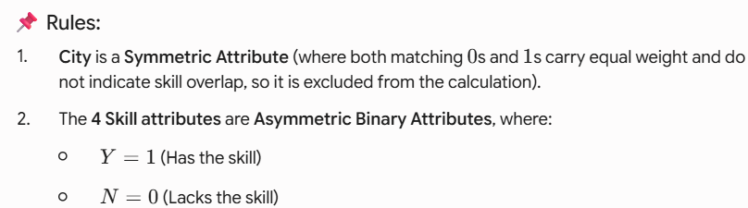
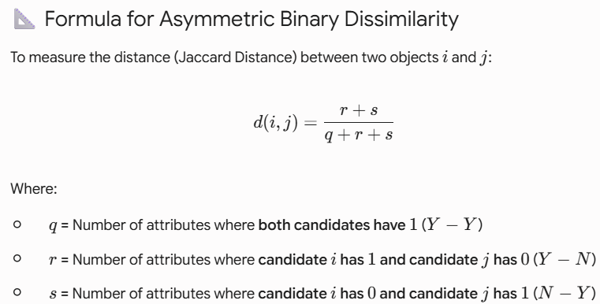
Simple Example: Job Candidate Technical Skills

Slide 20
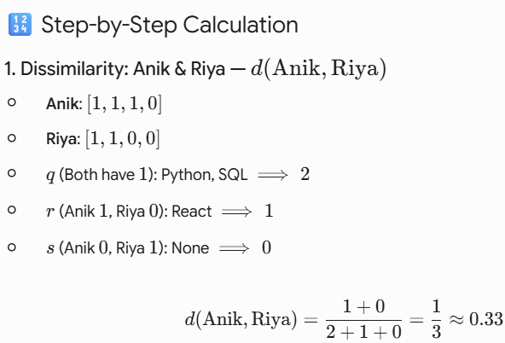
Simple Example: Job Candidate Technical Skills
Candidate | City | Python | SQL | React | Machine Learning
Anik | Dhaka | Y | Y | Y | N
Riya | Dhaka | Y | Y | N | N
Sakib | Chittagong | N | N | N | Y

Slide 21
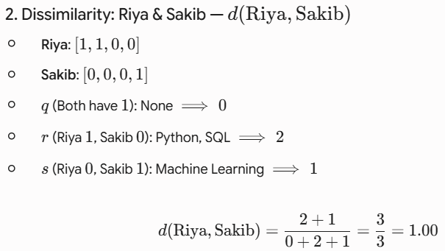
Simple Example: Job Candidate Technical Skills
Candidate | City | Python | SQL | React | Machine Learning
Anik | Dhaka | Y | Y | Y | N
Riya | Dhaka | Y | Y | N | N
Sakib | Chittagong | N | N | N | Y

Slide 22
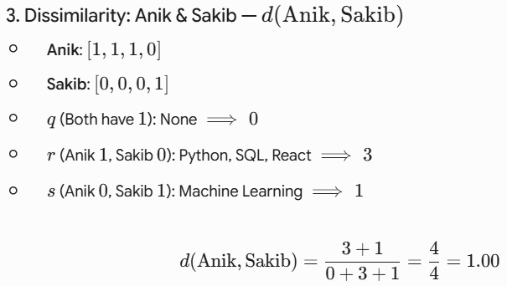
Simple Example: Job Candidate Technical Skills
Candidate | City | Python | SQL | React | Machine Learning
Anik | Dhaka | Y | Y | Y | N
Riya | Dhaka | Y | Y | N | N
Sakib | Chittagong | N | N | N | Y

Slide 23
Simple Example: Job Candidate Technical Skills
Anik and Riya have the lowest dissimilarity score (0.33),
  meaning they have the most similar skill set
  (Web/Backend engineering focus).
Sakib has maximum dissimilarity (1.00) with both
  Anik and Riya, because Sakib specializes entirely in
  Machine Learning, having zero skill overlap with the other two candidates.

Slide 24
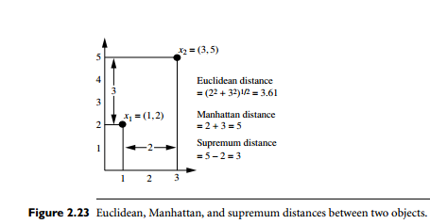
Dissimilarity of Numeric Data: Minkowski Distance

Slide 25
What is Minkowski Distance?
The Minkowski Distance is a general formula for computing distance between two numerical vectors.

Slide 26

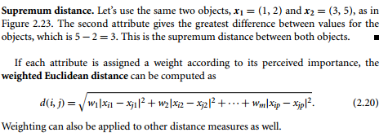
Dissimilarity of Numeric Data: Minkowski Distance

Slide 27
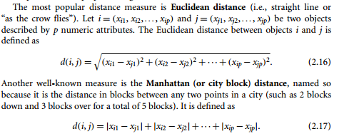
Dissimilarity of Numeric Data: Minkowski Distance

Slide 28
Dissimilarity of Numeric Data: Minkowski Distance
Both the Euclidean and the Manhattan distance satisfy the following mathematical properties:
  Non-negativity: d(i, j)>=0: Distance is a non-negative number.
  Identity of indiscernibles: d(i, i)= 0: The distance of an object to itself is 0.
  Symmetry: d(i, j)= d(j,i): Distance is a symmetric function.
  Triangle inequality: d(i, j)= d(i, k)+ d(k, j)= : Going directly from object i to object j in space is no more than making a detour over any other object k.
  A measure that satisfies these conditions is known as metric.

Slide 29
Distance on Numeric Data: Minkowski Distance
Minkowski distance: A popular distance measure
  where i = (x_{i1}, x_{i2}, …, x_{ip}) and j = (x_{j1}, x_{j2}, …, x_{jp}) are two p-dimensional data objects, and h is the order (the distance so defined is also called L-h norm)
Properties
  d(i, j) > 0 if i ≠ j, and d(i, i) = 0 (Positive definiteness)
  d(i, j) = d(j, i) (Symmetry)
  d(i, j) ≤ d(i, k) + d(k, j) (Triangle Inequality)
A distance that satisfies these properties is a metric

Slide 30


Ordinal Variables
An ordinal variable can be discrete or continuous
Order is important, e.g., rank
Can be treated like interval-scaled
  replace x_{if} by their rank
  map the range of each variable onto [0, 1] by replacing i-th object in the f-th variable by
  compute the dissimilarity using methods for interval-scaled variables

Slide 31
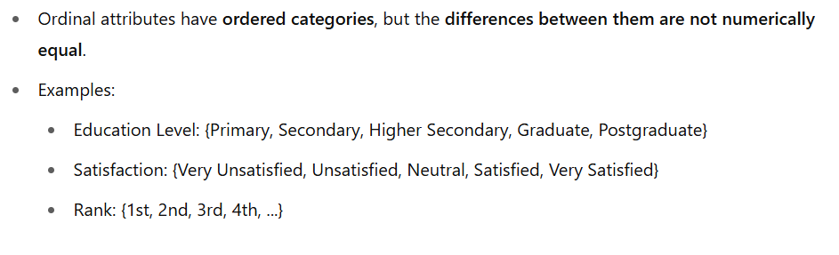
Ordinal Variables

Slide 32
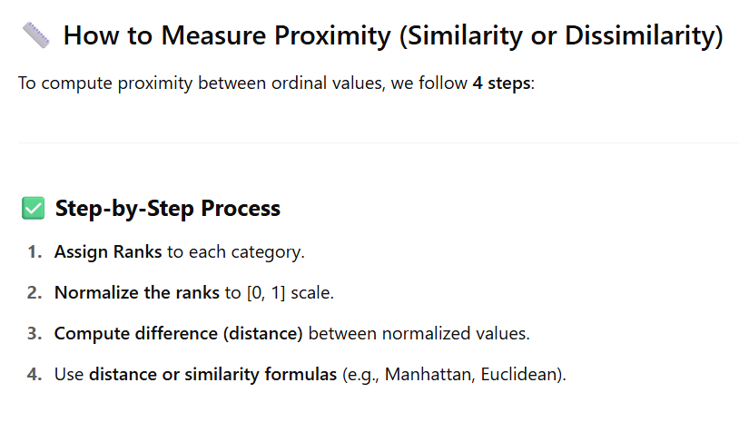
Ordinal Variables

Slide 33
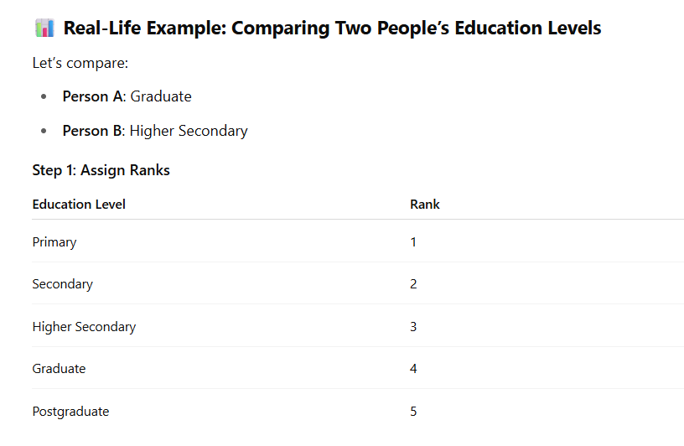
Ordinal Variables

Slide 34
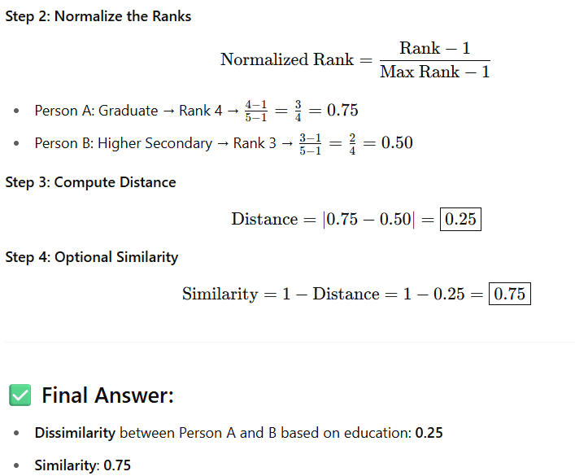
Ordinal Variables

Slide 35
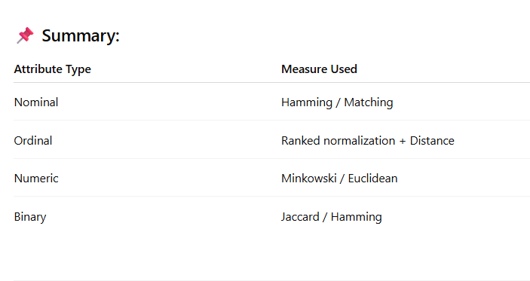
Ordinal Variables

Slide 36
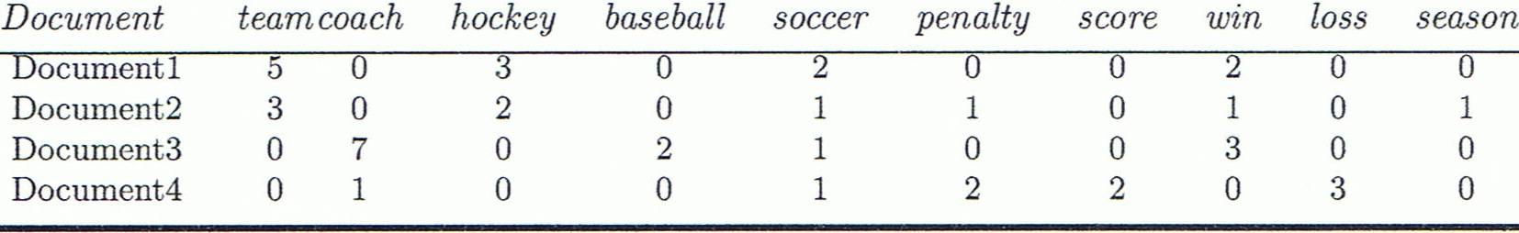
Cosine Similarity
A document can be represented by thousands of attributes, each recording the frequency of a particular word (such as keywords) or phrase in the document.
Other vector objects: gene features in micro-arrays, …
Applications: information retrieval, biologic taxonomy, gene feature mapping, ...
Cosine measure: If d₁ and d₂ are two vectors (e.g., term-frequency vectors), then
cos(d₁, d₂) = (d₁ • d₂) /||d₁|| ||d₂|| ,
  where • indicates vector dot product, ||d||: the length of vector d

Slide 37
Example: Cosine Similarity
cos(d₁, d₂) = (d₁ • d₂) /||d₁|| ||d₂|| ,
  where • indicates vector dot product, ||d|: the length of vector d
Ex: Find the similarity between documents 1 and 2.
  d₁ = (5, 0, 3, 0, 2, 0, 0, 2, 0, 0)
  d₂ = (3, 0, 2, 0, 1, 1, 0, 1, 0, 1)
  d₁•d₂ = 5*3+0*0+3*2+0*0+2*1+0*1+0*1+2*1+0*0+0*1 = 25
  ||d₁||= (5*5+0*0+3*3+0*0+2*2+0*0+0*0+2*2+0*0+0*0)^{0.5}=(42)^{0.5} = 6.481
  ||d₂||= (3*3+0*0+2*2+0*0+1*1+1*1+0*0+1*1+0*0+1*1)^{0.5}=(17)^{0.5} = 4.12
  cos(d₁, d₂ ) = 0.94

Slide 38


Slide 39
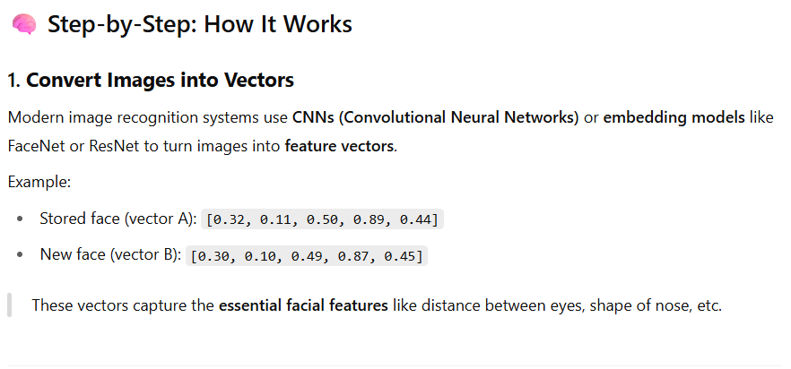

Slide 40
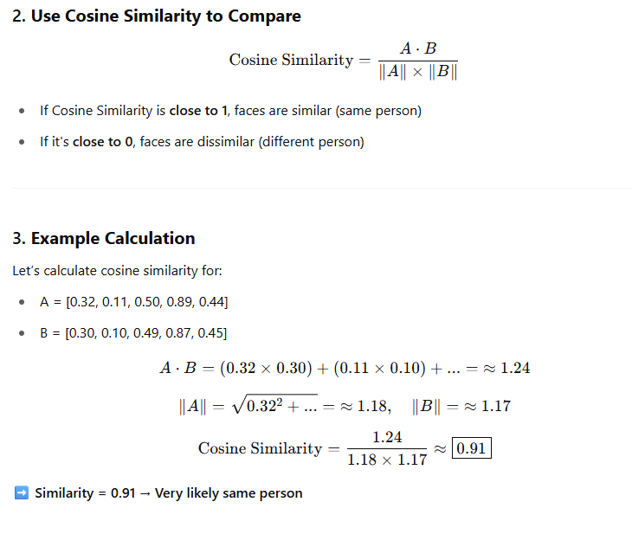

Slide 41
